Slide 1
Designed by Eri Hiroishi, BBSS Corporation. Copyright © Council of Anti-Phishing Japan ALL RIGHTS RESERVED.

Slide 2
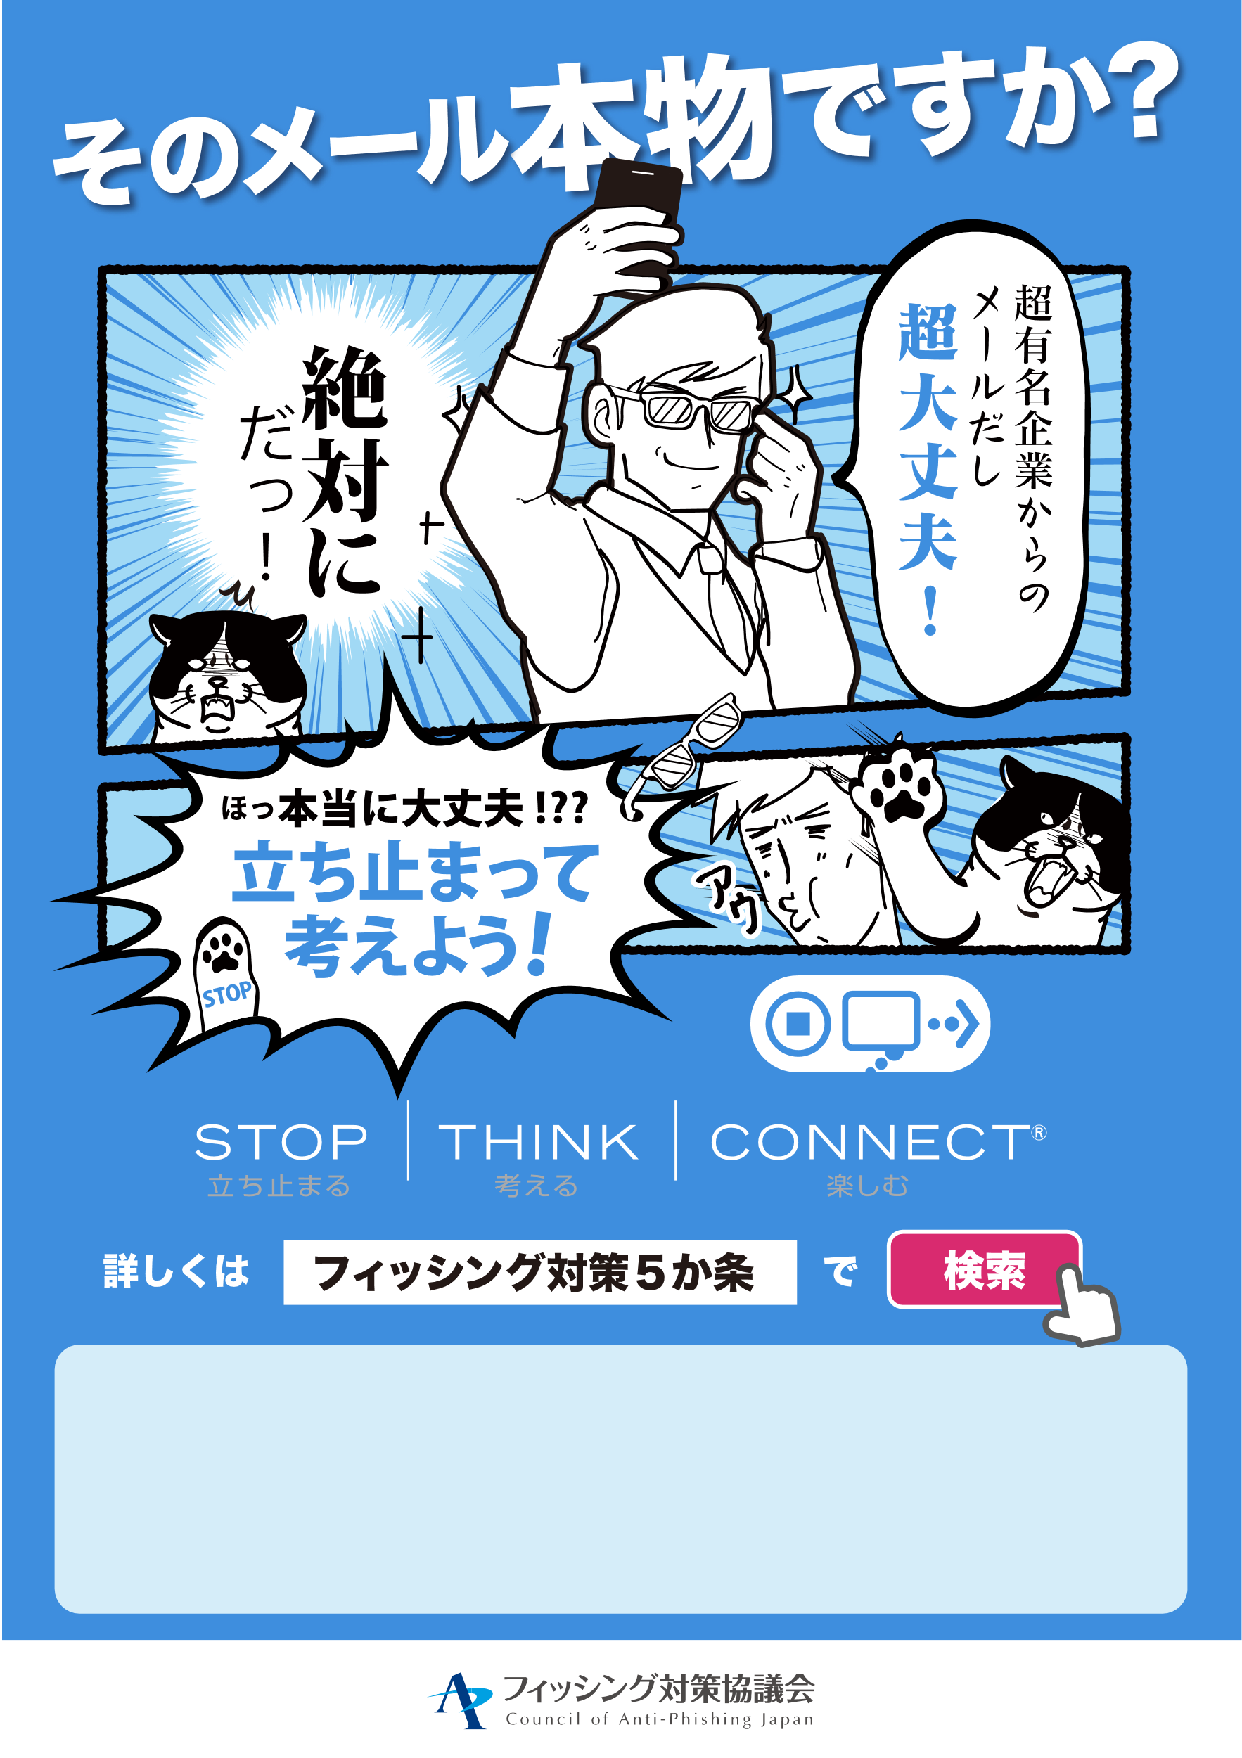
（ここに自由にメッセージを入れてご活用ください）
Designed by Eri Hiroishi, BBSS Corporation. Copyright © Council of Anti-Phishing Japan ALL RIGHTS RESERVED.

